Slide 1



Ground Systems Survivability Robustness Analysis through Model- Based Systems Engineering (MBSE)
Final Capstone Presentation
4 June 2013
Presented by:
David Basala Bill Berklich
Christine Brennan Steve Mazza
Joe Rambousek Donna Ray
Dan Torres
SE311-114G Vehicle Survivability

Slide 2
AGENDA
Introduction – Bill - 8 min
MBSE methodology – Donna - 7 min
Systems architecture – Dan - 7 min
Model development – Joe - 7 min
Model Execution – David - 7 min
Results – Christy - 12 min
Conclusions – Steve - 12 Min

Slide 3
BACKGROUND
Combat vehicles have historically balanced the iron triangle of survivability, lethality, and mobility in design to meet the requirements of affordable force effectiveness. To date, increasing protection has meant adding armor (or other technologies such as soft and hard-kill active protection and signature management) adding weight which decreased mobility and adding significant cost. The idea that increasing lethality or mobility would also increase survivability has been supported with professional military judgment, but no analytic metrics have been developed that can trade the weight of armor protection for increased mobility or increased lethality.

Slide 4
PRIMITIVE NEED
The U.S. Army Maneuver Center of Excellence (MCoE) has interest in analytically understanding the interplays and interactions with respect to the integrated survivability of a combat unit. More specifically they need to understand how the addition or subtraction of specific capabilities impact the overall unit survivability and mission success.

Slide 5
PROBLEM STATEMENT
This Team will design and analyze a company-level ground combat mounted maneuver unit in a combined arms scenario, with the intent of providing clear, quantitative understanding of the design trade-space. The trade-space consists of the combat vehicle and its infantry squad and relates to other mission capabilities such as mobility, lethality, networked communications, and others as they apply to survivability outcomes. The design solutions will include the breadth of DOTMLPF considerations.

Slide 6
RESEARCH QUESTIONS
Can a relationship be demonstrated between survivability of a small, task organized combined arms unit and improvements in lethality, mobility, and situational awareness through quantitative simulation analysis?
Can the trade-space among key input variables (lethality, mobility, etc.) be quantified and understood?
What are appropriate analytic metrics that can indicate the potential impact on combat infantry vehicle survivability due to increased mobility or increased lethality?

Slide 7
PROBLEM SPACE BOUNDARIES
focused on defining a process to assess combat vehicle survivability within the context of the combined arms unit.
did not address force protection and assumed in the context of the model that if a vehicle did not survive its crew also did not survive.
basis for the model development in this paper was, Alternative approach for the development of future Ground Combat System specification (Tobias Treml 2013) and Treml’s concurrent supporting model
model and model analysis is unclassified and contained no classified or For Official Use Only (FOUO) data
Notes:
The purpose for the methodology is so that each time a new unit, mission or system is introduced it would not require a start from scratch approach, but rather identify the key data necessary to implement the process and achieve the desired analysis and provide a results driven design. It is key to identify that this process will be a scoped down version of the necessary process required to carry out a fully integrated evaluation of survivability in terms of system of systems.
This will allow for a weighting factor to be included in the evaluation of the mission likelihood as well as to explore multiple uses for the process.
With the vast definition of the system of systems and the scope to identify all the integration elements, the team will limit the interdependencies and relationships to the systems directly impacted by the identified parameters. Therefore, the team will not be looking at the secondary and tertiary effects of the interdependencies such as fuel economy or reliability. This is critical to understand because the SoS relationships are incredibly integrated, expansive and difficult to identify. Therefore, it is necessary to scope the limits of our SoS architecture development.
Finally, an analysis of alternatives will be completed to identify the current capabilities and tools that exist to implement this process for a more user friendly interface as well as to recommend the path forward for follow-on efforts

Slide 8
MBSE System Engineering
Operational requirements
analysis of the survivability
capability
Problem
Definition
Capabilities Assessment
Preliminary system architecture
development to build top level
requirements for system survivability
System
Requirements
Test Assessments
Functional analysis of the
system survivability top level
requirements to develop the
technical requirements
System
Analysis
Integration
Component
Design
Component
Development
Allocation of measures of
performance and effectiveness
for the models
Modeling and
Simulation
Notes:
Application of the system vee process to MBSE
The MBSE domain is primarily on the left side of the system vee model for the system conceptual, requirements and architecture design
The survivability conceptual system architecture and operational requirements were derived from operations described in the Army’s Universal Task List (Department of the Army Headquarters 2009). The architecture and requirements were integrated into the operational scenario that was used to develop the mission profile for the operations effects model.

Slide 9
MBSE PROCESS DEVELOPMENT
Analyze the combat unit Survivability through simulation modeling to identify factors and trade-space performance that affect the SOS measures of survivability effectiveness
Survivability scenario and measures of effectiveness (MOE)
Functional performance requirements and MOE
SOS functional performance factors that affect MOE
Define the range of the performance factors that will be tested
Align modeling parameters with simulation
Develop an efficient DOE that includes the key performance aspects that can be applied in the simulation that will produce results for a meaningful range of performance levels for the survivability measures of effectiveness
Notes:
MBSE for military based scenario has been demonstrated and proven
Beery, Walton have used MBSE models to analyze military operational scenarios using MANA agent based model and ExtendSim simulations to develop response surfaces from the modeling factors and responses
These models have dealt with operational effects, since the models for operational effects are simpler than physical models but yield . It is possible to develop physical based models that provide detailed component design analysis. Operational effects models can be used to review different configurations composed of the same family members. The range of levels in the model are designed to produce results that provide data in a meaningful range of performance levels.
Joint Capabilities Integration and Development System (JCIDS) survivability key performance parameter (KPP) definition (U.S. Department of Defense 2012)
TRADOC Analysis Center’s Multi-Level Scenario Module 2 – IX Corps (MLS2) (2008)
Army Unified Land Operations (2011)

Slide 10
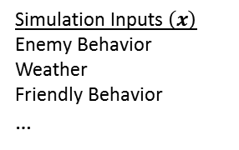
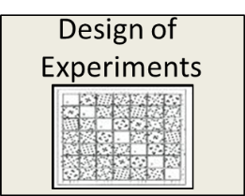
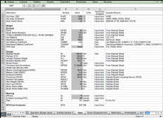
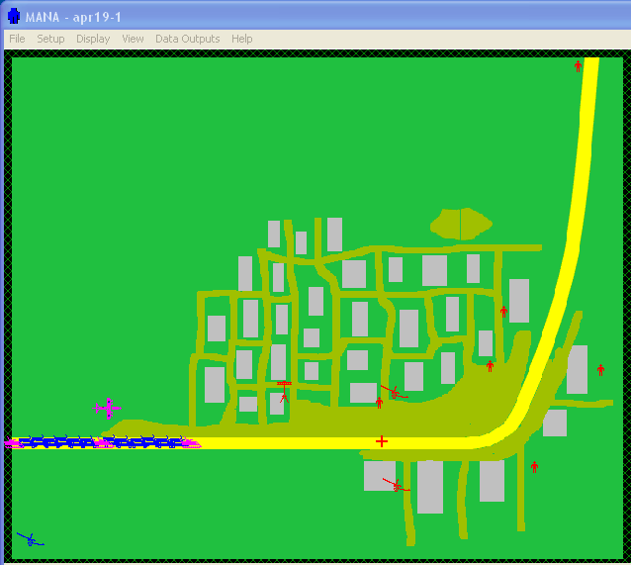
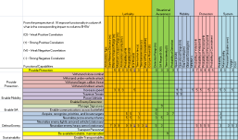

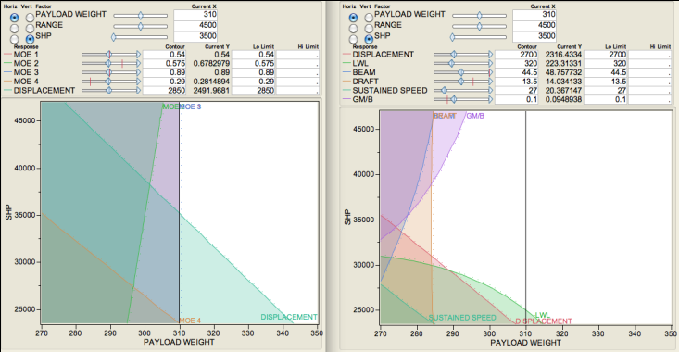


Army Survivability Project Using MBSE
Real Environment
Design-To Specifications
Environmental / Operational Factors
Operational Simulation Model
Synthesis Model
Design Parameters
Simulation Inputs $\left(x\right)$
Mobility (vehicle speed)
Lethality (weapon range,
weapon type, P(K))
Lethality (weapon type)
SA (detection range,
P(detect)
Tactics…
Synthesis Inputs $\left(x\right)$
C² System
Sensor Type
# of Guns
Gun Type
…
Excel
MANA
Operational Surrogate Model of Simulation
Physical Surrogate Model of Synthesis
*Map simulation inputs to synthesis inputs using heuristics, regression analysis or directly.
Operational Constraints
Trade Space
Physical Constraints
Synthesis Outputs (DOTMLPF)
MOEs
Simulation Outputs y(x)
Survivability
Force Protection
Mission Success
Synthesis Outputs y(x)
Doctrine changes
Organization changes
Materiel (Bradley, Abrams, etc)
Personnel, Training
Deployability
Cost
Operational Space
Solution Design Space

Slide 11
PROCESS
Operational Analysis
System Architecture
System Analysis
Model Development
Model Execution
Define unit operations
Develop Use Cases
Develop MOEs
Outputs: Scenarios for analysis, Unit for Analysis
Define functionality
Determine flows
Identify MOPs
Outputs: Operational Architectures, Use Cases, MOEs
Gather data Specify analysis Identify data requirements
Outputs: Architectures
Architecture defines SoS
Build simulation
Outputs: Model with data requirements and System Metrics
Execution Use Case
Evaluate data
Outputs: Baseline Results, Alternative Configuration Results
* Tailored version of the DoD SE “V” and the current process being implemented within the PEO CS&CSS Product Manager Contingency Basing Infrastructure

Slide 12
STAKEHOLDERS

Slide 13
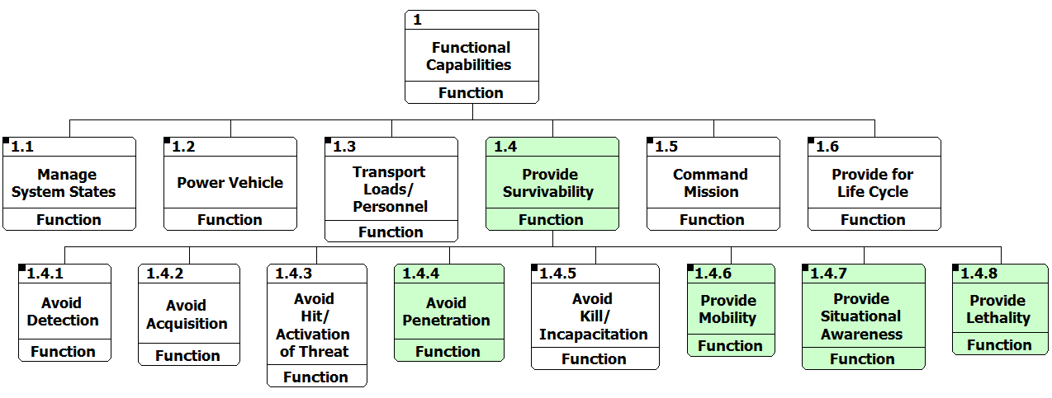
FUNCTIONAL DECOMPOSITION
Notes:
The functional hierarchy aids in decomposing high level abstractions into elements that have measureable properties and can be instantiated as physical elements in the simulation model.

Slide 14
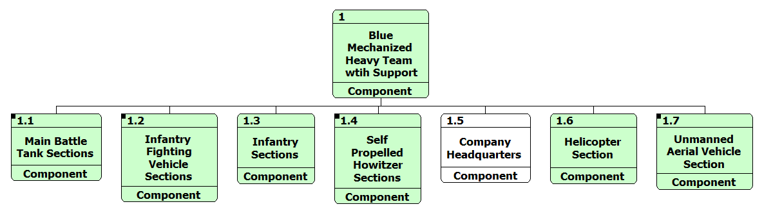
PHYSICAL DECOMPOSITION
Notes:
The architectural view of the baseline high level physical architecture is shown above, these elements are indicated on the IDEF0 diagram as the components which are host to the functions. The component descriptions are defined without associated physical instantiations such that a diverse set of design solutions can be integrated into the system model.

Slide 15
SYSTEMS ANALYSIS
Notes:
Actual success criteria for a particular system is Based on the operational capabilities as Defined in the system’s capability definition document. The objective of these simulations is not to establish a mission threshold limit, but to determine the factors Which have the greatest positive influence on Survivability A constraint of mission equivalent run time equal to less than 14 combat hours for the BLUE tanks is an artifact of the model to ensure the model does not allow scenarios of indefinite run lengths.

Slide 16
MODEL DEVELOPMENT
ANALYSIS TOOLS
1. Sanchez, S. M. 2011. NOLHdesigns spreadsheet. Available online via http://harvest.nps.edu/
[accessed 02/18/2013]
Notes:
Prior to developing a design of experiment (DOE), the team needed to have a better understanding in two key areas. 1) What are the required capabilities of ground combat vehicles (both legacy and future design)? 2) Which combat vehicle performance capabilities are the most critical to mission success, and which possess the greatest trade space? That is, which performance modifications will have the greatest impact (positive or negative) on mission success?
The team spoke with subject matter experts that were part of the GCV Whole Trades Analysis Team, as well as reviewed the GCV WSTAST technical report. The information obtained help to glean which combat vehicle attributes would be most essential in our analysis. An initial assembly of 15 performance attributes were narrowed down to 9 through a value weighting exercise, as well as by understanding which attributes were modifiable within MANA (our modeling software).
These 9 attributes were defined as our design factors, and through research of current combat vehicle performance requirements, as well as SME input, assigned an appropriate design space for each factor. With the ranges in hand, the team utilized the NPS SEED Nearly Orthogonal Latin Hypercubes design of experiments worksheet for 11 factors (a 10 factor worksheet was not available, but would contain fewer trial runs).
The NOLH 11 factor worksheet specified 33 trial runs, defining various configurations of the design factors. To minimize the chance involved in a single run outcome, the team settled on a 5-run series for each defined trial configuration, totalling 165 MANA runs. All output data from each 5-run series would be averaged, and that value included as the trial result.

Slide 17
MODEL DEVELOPMENT
SIMULATIONS

Slide 18
Baseline Mission Scenario
BLUE Force is a balanced company team (1 mech platoon, 1 tank platoon) of a Combined Arms Battalion which attacks along a major highway 30 km south to take Objective 1 as prerequisite for the future attack of the Battalion against Objective HAWK.
The company is the major effort with priority indirect fire support and is the main focus of the Battalion UAV reconnaissance effort. Apache attack helicopters will provide close air support and additional reconnaissance capabilities.
The Battalion Commander's intent for the company team is to maintain as much offensive momentum as possible to keep the enemy off balance but also to destroy detected enemy in the area of operations. After reaching Objective 1 the company team will secure the objective until follow-on forces attack over own positions to Objective HAWK.
Notes:
Several reasons lead the Team to select Mr. Treml’s Operations Research Thesis “New Approach for the Development of Specifications for a Future Ground Combat Vehicle“ and supporting model as a basis for our model development. First, as we studied the problem it became apparent that using ExtendSym would be problematic due to it’s limitations with respect to defining terrain, sight lines and agent interaction to the level needed. Second, Treml’s completed model, on inspection, offered the team a far richer environment than we could create in the given time and with our existing skill set. Last, because the model was developed in MANA, it provided the Team with very solid technical support as we made modifications.
Additionally, the Treml model already incorporated both the terrain type and the force disposition (reinforced Mech Company with air support) which we had decided on as our key model elements.

Slide 19
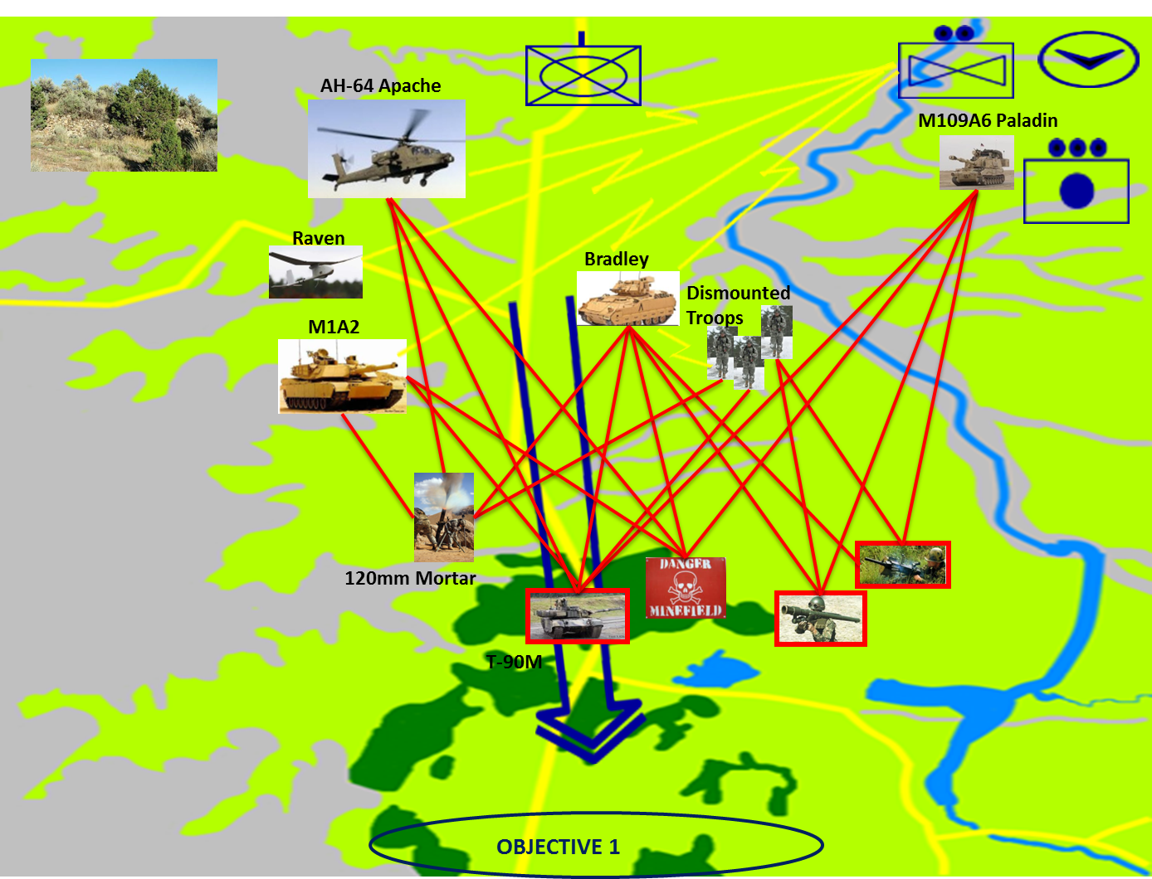
OV-1
Notes:
The OV-1 here shows the relative initial disposition of Blue Company (+). The Blue line of attack is shown as the Blue Arrow running from North to South ; 2-way voice and data communication linkages from Company elements to HQ (Yellow Bolts) and Blue - Red tactical engagements (red lines). Objective 1 for Blue Company (+) is at the southern extreme of the battle area.

Slide 20
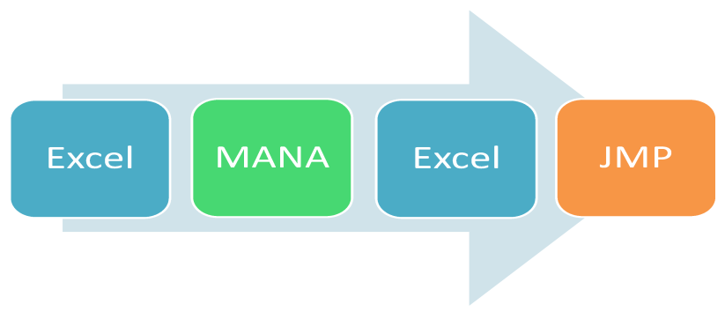
MODEL EXECUTION
Map Aware Non-uniform Automata (MANA)
Agent-based simulation
Squads
Agents
NOLH Baseline simulation
66 configurations
35 replications
MANA

Slide 21
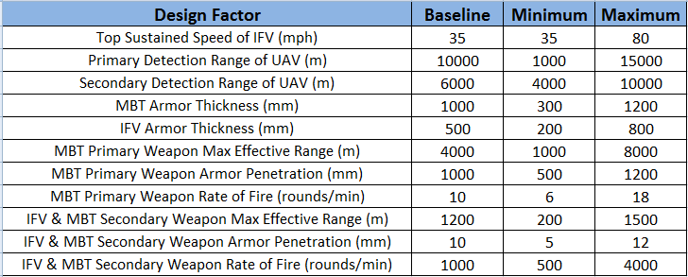
MODEL EXECUTION (cont…)
Design Factors

Slide 22
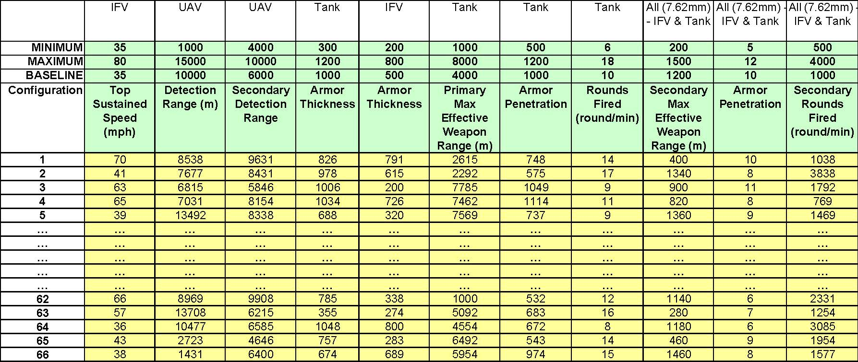
MODEL EXECUTION (cont…)
Simulation trials

Slide 23
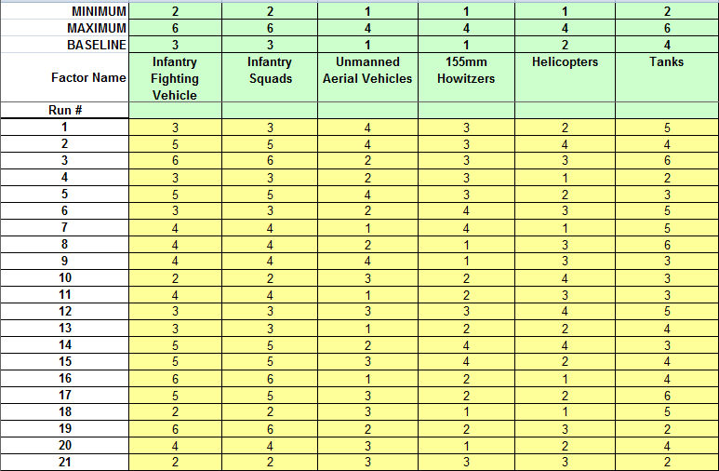
MODEL EXECUTION (cont…)
Non-materiel unit composition

Slide 24
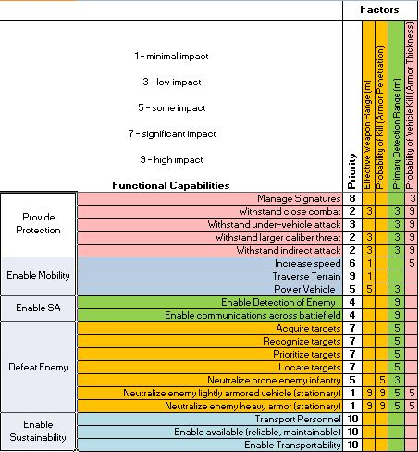
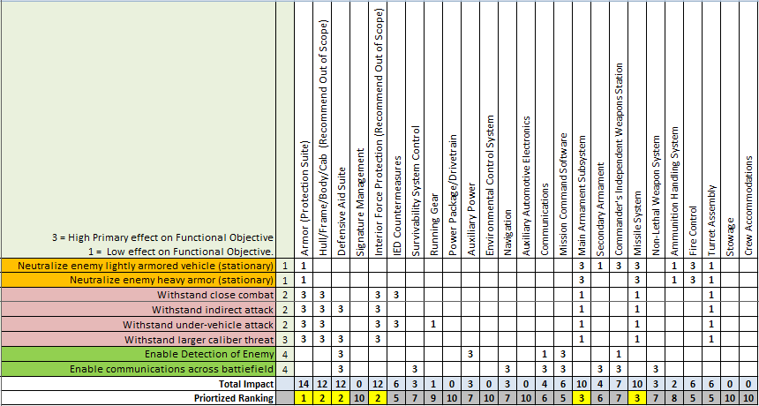
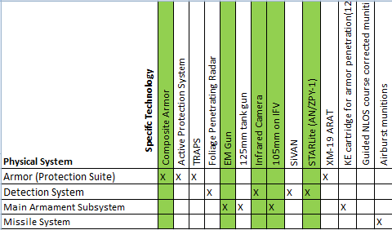
MODEL EXECUTION (cont…)
Materiel change configurations
Prioritize Functions Prioritize Systems System-to-technology

Slide 25
RESULTS
Notes:
Utilizing the NOLH 11 factor DOE, along with the Tremel OR scenario, the team modified attributes within MANA to align with the design factor configurations.
The baseline squad properties, as defined by the Tremel scenario, were modified in accordance with each trial run, and then run 5 times. Design factors “Top Sustained Speed” (Bradley), “Armor Thickness” (Bradley & Abrams), “Armor penetration” (Abrams 120mm, Bradley & Abrams 7.62mm), and “Rounds Fired” (Abrams 120mm & Bradley/Abrams 7.62mm) all aligned with specific modifiable attributes within the MANA squad properties.
Design factors “Detection Range” (Raven UAV), “Max Effective Primary Weapon Range” (Abrams 120mm), and “Max Effective Secondary Weapon Range” (Bradley & Abrams 7.62mm) all are assigned in accordance with a matrix design. That is, for increasing ranges, beginning with 0, the detection accuracy and weapon hit rate decrease in probability. Because this type of data is either unavailable or classified, the team could not attempt to modify the baseline values for all ranges.
Assumption for detection range were made such that the detection of a vehicle was at least as accurate as the detection of infantry. Additionally, the assigned probability for the greatest baseline detection range, was assumed as the probability for the new detection range, defined by the DOE trials (all of which were lower than baseline).
Assumption for max effective weapon range is that to be “effective,” a weapon possess a hit rate of 90%. Thus, at range 0, P(h) = 100%, and at max effective weapon range (defined by the DOE trial) P(h) = 90%. No other interim ranges were assigned. Additionally, the team utilized the MANA internal interpolation algorithm for all ranges between 0 and MAX.

Slide 26
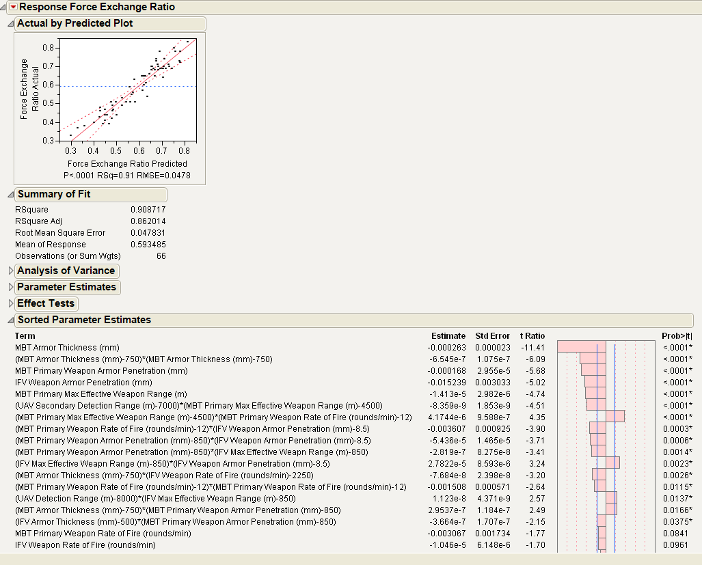
BASELINE ANALYSIS
Extremely capable MBTs can overwhelm the enemy to the point that the performance capabilities of the supporting assets are insignificant. However, it should be noted that this significance is based on extreme variations in MBT capabilities, and these patterns may disappear if the solution space is restricted.
Given these trends, indicator variables were developed that grouped the data based on the splits identified by the partition trees.
When the MBT is extremely capable, the Force Exchange Ratio becomes dependent on the UAV Secondary Detection Range (which provides target information to the MBTs) as well as the MBT Primary Weapon Armor Penetration (which increases the lethality of the Main Battle Tank).
Primary Maximum Effective Weapon Range
Probability of Kill (Armor Penetration
Detection Range
Probability of Vehicle Kill (Armor Thickness)

Slide 27
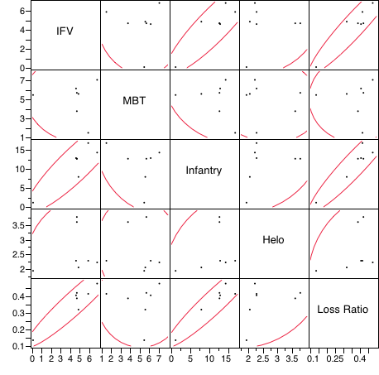
ALTERNATIVE CONFIGURATIONS
Evaluated 6 alternative Technologies
EM Gun performed best overall
Evaluated 21 alternative unit composition configurations by varying the existing platform numbers
Configuration 6 performed best and consisted of 3 IFVs and dismounted squads, 2 UAVs, 3 helicopters, 4 Howitzers and 5 MBTs.
Assessed configurations in MANA against the 5 MOEs

Slide 28
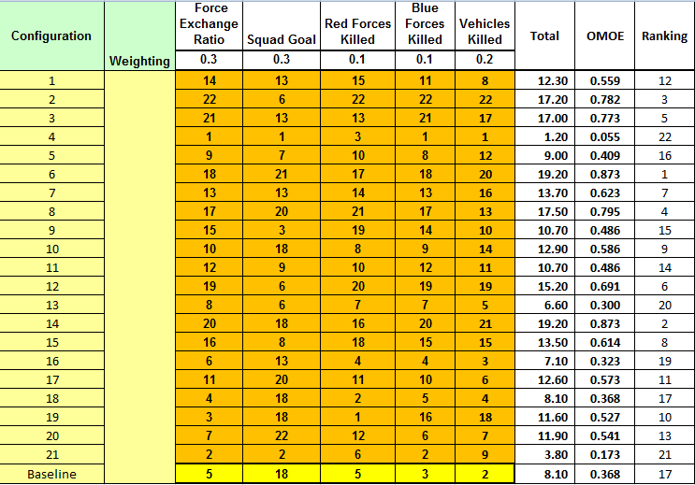
OVERALL MEASURES OF EFFECTIVENESS (OMOE)
There were many inputs that were integrated to determine the overall survivability effectiveness for the given unit:
FER
Blue Force losses
Red Force losses
Blue Force mission success
Blue Force vehicle losses
Based solely on the assessment of performance as it relates to the identified MOEs, configurations 6, 14 and 2 were the top non-materiel performers

Slide 29
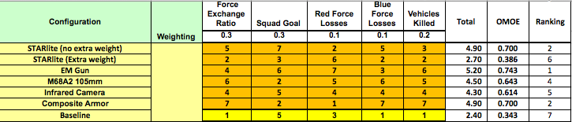
OVERALL MEASURES OF EFFECTIVENESS (OMOE)
For the materiel configuration changes the composite armor, EM gun and STARlite detection system (assuming no additional weight) provided the best performance

Slide 30
COST AS AN INDEPENDENT VARIABLE (CAIV) ASSESSMENT
“CAIV is a strategy that entails setting aggressive, yet realistic cost objectives when defining operational requirements and acquiring defense systems and managing achievement of these objectives…As system performance and cost objectives are decided (on the basis of cost-performance trade-offs), the requirements and acquisition processes will make cost more of a constraint, and less of a variable, while nonetheless obtaining the needed military capability of the system” (Young 2012, 27).

Slide 31
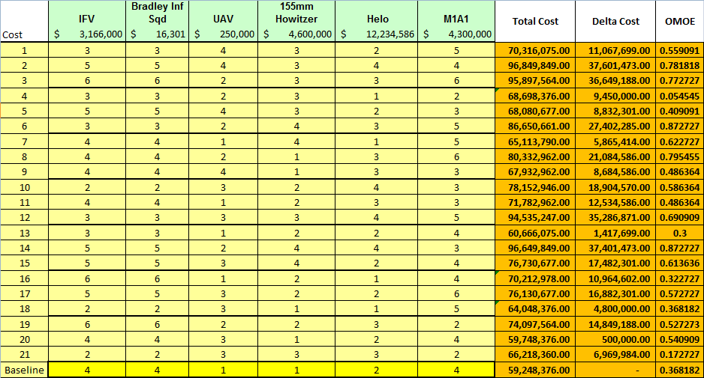
COST AS AN INDEPENDENT VARIABLE (CAIV) ASSESSMENT – NON-MATERIEL
For the development of the non-materiel solutions cost estimates all the information was obtained from publically accessible websites such as CNN and FAS.
Each unit cost was multiplied by the number of platforms in a configuration.
The total amount was determined for the entire unit, based upon the number and cost of each system.
Costs are only production costs. O&S assessment needs to be follow-on work

Slide 32
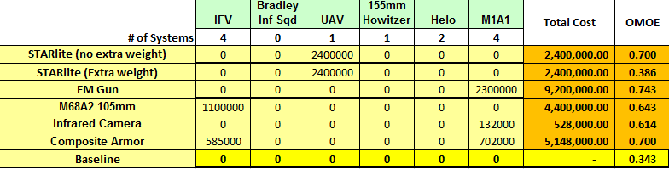
COST AS AN INDEPENDENT VARIABLE (CAIV) ASSESSMENT – MATERIEL
The cost for each system was then determined and multiplied by the number of platforms it would be deployed on in the given unit.
This allowed the cost per unit to be determined based solely on production costs.
Each system cost was determined differently mostly through publically available knowledge or SME information

Slide 33
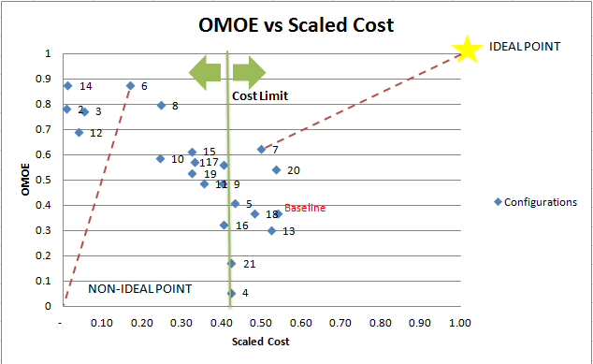
OMOE AND CAIV RESULTS
Technique for Order Preference by Similarity to Ideal Solution (TOPSIS) evaluation was performed.
The ideal non-materiel solution was configuration 7
Configuration 6, which was furthest from the non-ideal point
The green vertical line identifies the set cost limit for the program as to not exceed budget
Notes:
The TOPSIS theory states that the best configuration is the one that is the closest to the ideal point and furthest from the non-ideal point (Young, 2012). The ideal point is the highest possible OMOE and no money, represented by an OMOE of 1 and a scaled cost of 1, whereas the non-ideal point is high cost for no OMOE gain, represented by an OMOE of 0 and a scaled cost of 0.
Based on Figure 50, the best solutions were configuration 7, closest to the ideal point, and configuration 6, furthest from the non-ideal point. Configuration 7 consisted of four IFVs and dismounted squads, one UAV, one helicopter, four Howitzers and five MBTs. Similarly, configuration 6 consisted of three IFVs and dismounted squads, two UAVs, three helicopters, four Howitzers and five MBTs. The commonality between the two configurations is the increased heavy guns to improve the lethality of the unit, which in turn improved the survivability.

Slide 34
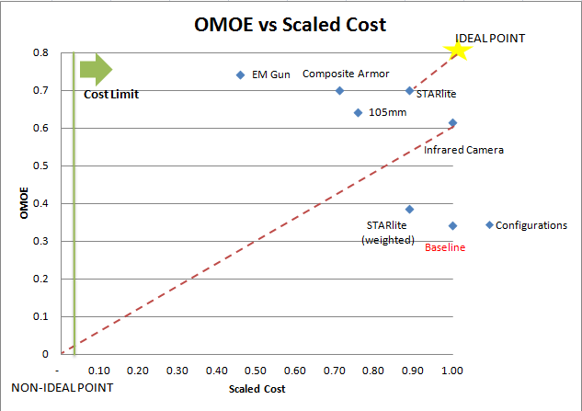
OMOE AND CAIV RESULTS
The results of the CAIV and OMOE assessments suggested that either the lethality of the unit or the detection capability of the unit needed to be improved
For the materiel solutions, the best solution was either STARlite, assuming no weight gain, or the upgraded GEN III FLIR.
The comparison of the two different configurations of the STARlite technology provides some insight to the importance of the secondary effects considerations
Notes:
Additionally, the comparison of the two different configurations of the STARlite technology provides some insight to the importance of the secondary effects considerations. According to this assessment if there is no additional weight compared to the current detection system employed on the UAV, then the new detection system would provide a significant advantage. Judging from both the OMOE assessment and the CAIV analysis, , if there was additional weight, the ROI for the system drops significantly. This was due to the secondary effects of that weight, which reduce the speed of the UAV, reduced the distance it could travel, and increased frequency with which refueling was required. Therefore, this showed one example of how important the secondary effects calculations were to providing more realistic and operationally relevant results to the end user.

Slide 35
SUMMARY AND CONCLUSIONS
Challenges
Toolset
Data classification
Follow-on work
Dashboard
In-depth analysis
Emerging technologies
Trade-space
Conclusions
Value created by this effort

Slide 36
CHALLENGES
Lack of integrated MBSE toolset
Choice of tools is left up to the engineer
Developed process is independent of toolset
Classified data
Prohibited the use of realistic data in many cases
Forced several assumptions
Forced alteration of some data
Developed process is independent of the data

Slide 37
FOLLOW-ON WORK
Development of dashboard
Performance of analysis in greater depth
Investigation of emerging technologies
Broadening of the trade-space

Slide 38
Dashboard
Direct end-user manipulation of model parameters.
Extend technical capabilities to a broader audience.
Provide abstraction on the underlying analysis tools.
Provide early insight into the effects of design changes.
Help identify important design parameters.

Slide 39
Further Analysis
Interactions between MBT armor penetration and IFV maximum effective range.
Interactions between IFV rate of fire and IFV maximum effective range.
Lack of effectiveness in the model of IFV armor.
Detrimental effects in the model of IFV top speed.
Impact of increased situational awareness.

Slide 40
Emerging Technologies
Examples
High-energy weapons
E-ink camouflage
New ground combat systems
Could be evaluated under the developed process.

Slide 41
Trade Space
Currently limited to ground combat
Opportunities
Inclusion of consideration for air support
Factor limitations and improvements in logistics
Create scenarios for joint operations
Provide a more complete picture of unit effectiveness and health.

Slide 42
CONCLUSIONS
Developed a process that is:
Effective
Repeatable
Adaptable
Lays groundwork for additional research
Provide support for doctrinal and organizational changes
Demonstrate importance of SoS factors and effects
Provide support for feasibility study for emerging technologies

Slide 43
QUESTIONS

Slide 44
Back up

